Slide 1
Introduction to Networks
Jiawei Han
Computer Science
University of Illinois at Urbana-Champaign
January 26, 2017

Slide 2


Slide 3
Introduction to Networks
Basic Measures of Networks
Centrality Analysis in Networks
Modeling of Network Formation
Community Discovery and Cluster Analysis
A Brief Introduction to Social Networks
Summary

Slide 4
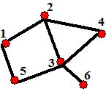
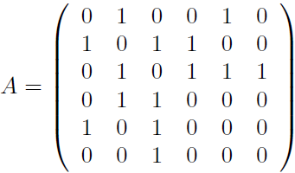
Networks and Their Representations
A network/graph: G = (V, E), where V: vertices/nodes, E: edges/links
E: a subset of V × V, n = |V| (order of G), m = |E| (size of G)
Adjacency matrix
A_{ij} = 1 if there is an edge between vertices i and j; 0 otherwise
Various kinds of networks:
Simple network: If a network has neither self-edges nor multi-edges
Multi-edge (multigraph): if more than one edge between the same pair of vertices
Self-loop: if an edge connects vertex to itself (i.e., (v_{i}, v_{i}))
Directed graph (digraph): if each edge has a direction (tail → head)
A_{ij} = 1 if there is an edge from j to i; 0 otherwise
Weighted graph: If a weight w_{ij} (a real number) is associated with each edge v_{ij}

Slide 5
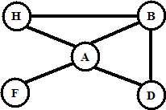
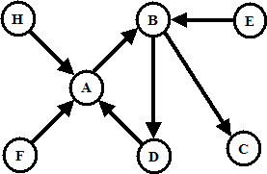
Vertex Degree for Undirected & Directed Networks
Let a network G = (V, E)
Undirected Network
Degree (or degree centrality) of a vertex: d(v_{i})
# of edges connected to it, e.g., d(A) = 4, d(H) = 2
Directed network
In-degree of a vertex d_{in}(v_{i}):
# of edges pointing to v_{i}
E.g., d_{in}(A) = 3, d_{in}(B) = 2
Out-degree of a vertex d_{out}(v_{i}):
# of edges from v_{i}
E.g., d_{out}(A) = 1, d_{out}(B) = 2

Slide 6
Various Kinds of Networks and Their Average Degrees
Undirected
Self-loops
Multi-graph
Directed
Weighted
Complete graph
L: toal # of links
<k>: average degree
Slides from L. Barabasi, Network Science, 2016

Slide 7
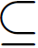
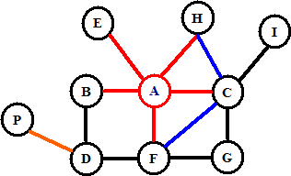
Basic Network Structures and Properties
Subgraph: A subset of the nodes and edges in a graph/network
Given a subset of vertices V’ V, the induced subgraph G’ = (V’, E’) consists exactly of all the edges present in G between vertices in V’
Clique (complete graph): Every node is connected to every other
Singleton vs. dyad (two nodes and their relationship) vs. triad:
B
D
A
C
F
E
Ego-centric network: A network pull out by selecting a node and all of its connections
The 1-degree egocentric network of A
The 1.5-degree egocentric network of A
The 2-degree egocentric network of A

Slide 8
Degree Distribution and Path
Degree sequence of a graph: The list of degrees of the nodes sorted in non-increasing order
E.g., in graph G₁, degree sequence: (4, 3, 2, 2, 1)
Degree frequency distribution of a graph: Let N_{k} denote the # of vertices with degree k
(N₀, N₁, …, N_{t}), t is max degree for a node in G
E.g., in graph G₁, degree frequency distribution: (0, 1, 2, 1, 1)
Degree distribution of a graph:
Probability mass function f for random variable X
(f(0), f(1), …, f(t), where f(k) = P(X = k) = N_{k}/n
E.g., in graph G₁, degree distrib.: (0, 0.2, 0.4, 0.2, 0.2)
Walk in a graph G between nodes X and Y: ordered sequence of vertices, starting at X and ending at Y, s.t. there is an edge between every pair of consecutive vertices
Hops: the length of the walk
Path: a walk with distinct vertices
Distance: the length of the shortest path
Graph G₁

Slide 9
Paths
Path: A sequence of vertices that every consecutive pair of vertices in the sequence is connected by an edge in the network
Length of a path: # of edges traversed along the path
Total # of path of length 2 from j to i, via any vertex in N_{ij}⁽²⁾ is
Generalizing to path of arbitrary length, we have:
When starting and ending at the same vertex i, we have:
# of loops can be expressed in terms of adjacency matrix
Matrix A written in the form of A = UKU^{T}, where U is the orthogonal matrix of eigenvectors and K is the diagonal matrix of eigenvalues
where k_{i} is the i-th eigenvalue of the adjacency matrix

Slide 10
Radius and Diameter of a Network
Eccentricity: The eccentricity of a node v_{i} is the maximum distance from v_{i} to any other nodes in the graph
e(v_{i}) = max_{j} {d(v_{i,} v_{j})}
E.g., e(A) = 1, e(F) = e(B) = e(D) = e(H) = 2
Radius of a connected graph G: the min eccentricity of any node in G
r(G) = min_{i} {e(v_{i})} = min_{i} {max_{j} {d(v_{i,} v_{j})}}
E.g., r(G₁) = 1
Diameter of a connected graph G: the max eccentricity of any node in G
d(G) = max_{i} {e(v_{i})} = max_{i, j} {d(v_{i,} v_{j})}
E.g., d(G₁) = 2
Diameter is sensitive to outliers. Effective diameter: min # of hops for which a large fraction, typically 90%, of all connected pairs of nodes can reach each other
Graph G₁

Slide 11
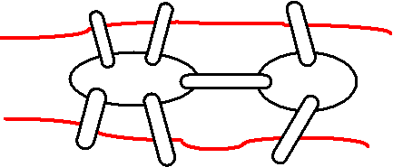
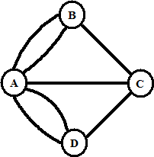
Various Kinds of Paths
Shortest path (geodesic path, d):
Geodesic paths are not necessarily unique: It is quite possible to have more than one path of equal length between a given pair of vertices
Diameter of a graph: the length of the longest geodesic path between any pair of vertices in the network for which a path actually exists
Average path length (<d>):
Average of the shortest paths between all pairs of nodes
Eulerian path: a path that traverses each edge in a network exactly once
The Königsberg bridge problem
Hamilton path: A path that visits each vertex in a network exactly once
For this graph, what is <d> ?

Slide 12
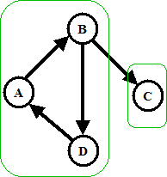
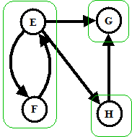
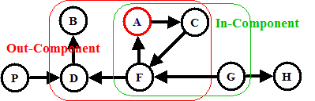
Components in Directed & Undirected Network
Undirected network:
Component: A subset of the vertices of a network such that there exists at least one path from vertex to each other vertex
Adjacency matrix of a network with more than one component can be written in block diagraph form
Directed network:
Weakly vs. strongly connected components
Weakly connected: if the vertices are connected by 1 or more paths when one can go either way along any edge
Out-component vs. in-component of a vertex (A) or a strongly connected component (A-C-F)
Out-component: Those reachable from vertex A
multiple size-2 edge/vertex cut set
The graph contains 2 weakly connected and 5 strongly connected components

Slide 13
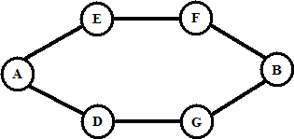
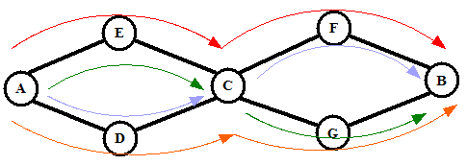
Independent Paths, Connectivity, and Cut Sets
Two path connecting a pair of vertices (A, B) are edge-independent if they share no edges
Two path are vertex-independent if they share no vertices other than the starting and ending vertices
A vertex cut set is a set of vertices whose removal will disconnected a specified pair of vertices
An edge cut set is a set of edges whose removal will disconnected a specified pair of vertices
A minimum cut set: the smallest cut set that will disconnect a specified pair of vertices
Menger’s theorem => maxflow/min-cut theorem: For a pair of vertices,
size of min-cut set = vertex connectivity = maximum flow
This works also for weighted networks
multiple size-2 edge/vertex cut set

Slide 14
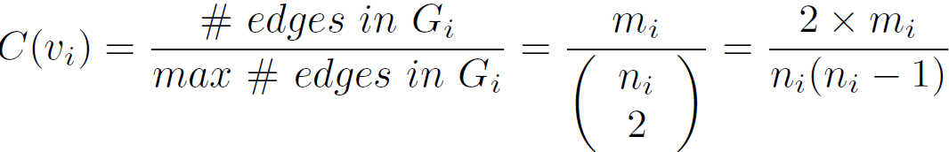
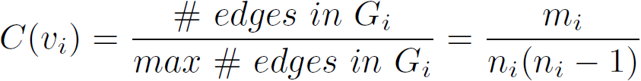
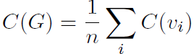
Clustering Coefficient
Real networks are sparse: Corresponding to a complete graph
Clustering coefficient of a node v_{i}: A measure of the density of edges in the neighborhood of v_{i}
Let G_{i} = (V_{i}, E_{i}) be the subgraph induced by the neighbors of vertex v_{i}, |V_{i}| = n_{i} (# of neighbors of v_{i}), and |E_{i}| = m_{i} (# of edges among the neighbors of v_{i})
Clustering coefficient of v_{i} for undirected network is
For directed network,
Clustering coefficient of a graph G:
Averaging the local clustering coefficient of all the vertices (Watts & Strogatz)
(corresp. to when G_{i} is a complete graph)

Slide 15
Bipartite Networks
Bipartite Network: two kinds of vertices, and edges linking only vertices of unlike types
Incidence matrix:
B_{ij} = 1 if vertex j links to group i
0 otherwise
One can create a one-mode project from the two-mode partite form (but with info loss)
The projection to one-mode can be written in terms of the incidence matrix B as follows
The product of B_{ki} B_{kj} will be 1 if i and j both belong to the sample group k in the bi-partite network

Slide 16
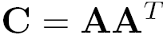
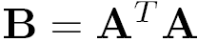
Co-citation and Bibliographic Coupling
Co-citation of vertices i and j:
# of vertices having outgoing edges pointing to both i and j
Co-citation matrix: It is a symmetric matrix
Diagonal matrix (C_{ii}): total # papers citing i
Bibliographic coupling of vertices i and j:
Bibliographic coupling of i and j:
Bibliographic coupling matrix:
Diagonal matrix (B_{ii}): total # papers cited by i
Vertices i and j are co-cited by 3 papers
Vertices i and j cite 3 same papers

Slide 17
Co-citation & Bibliographic Coupling: A Comparison
Two measures are affected by the number of incoming and outgoing edges that vertices have
For strong co-citation: must have a lot of incoming edges
Must be well-cited (influential) papers, surveys, or books
Takes time to accumulate citations
Strong bib-coupling if two papers have similar citations
A more uniform indicator of similarity between papers
Can be computed as soon as a paper is published
Not change over time
Recent analysis algorithms
HITS explores both co-citation and bibliographic coupling

Slide 18


Slide 19
Introduction to Networks
Basic Measures of Networks
Centrality Analysis in Networks
Modeling of Network Formation
Primitives of Social Networks
Summary

Slide 20
Centrality: Basic Measure in a Network
Centrality: How “central” a node is in the network
Degree centrality: degree of a node (the higher degree, more important the node)
Eccentricity centrality: the less eccentric, the more central
c(v_{i}) = 1/e(v_{i})
Central node: e(v_{i}) = r(G) (if it equals the radius of G)
Periphery node: e(v_{i}) = d(G) (if it equals the diameter of G)
Often used in facility location, e.g., emergency center
Closeness centrality: the average of the shortest path length from the node to every other node in the network, indicating how close a node is to all other nodes in the network
c(v_{i}) = 1/∑_{j} d(v_{i,} v_{j})
median node v_{m} if v_{m} has the smallest total distance ∑_{j} d(v_{m,} v_{j})
Facility location, e.g., shopping center, minimize total distance

Slide 21
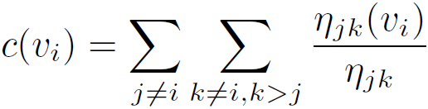
Centrality Measures (II)
Betweenness centrality for a node v: # of shortest paths from all vertices to all others that pass through v
η_{jk}: # of shortest paths between vertices v_{j} and v_{k}
η_{jk}(v_{i}): # of such paths that contain v_{i}
Betweenness centrality of a vertex v_{i}:
Indicating a central “monitoring role” played by v_{i} for various pairs of nodes
Eigenvector centrality: Measure the influence of a node in a network, i.e., connections to high-scoring nodes contribute more to the score of the node in question than equal connections to low-scoring nodes

Slide 22
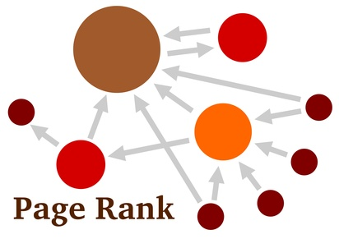
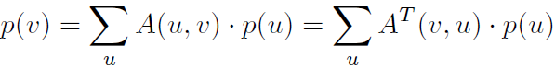
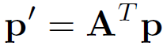
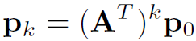
Centrality Measures on the Web (I): Eigenvector Centrality
Web: a directed graph, PageRank and HITS are typical algorithms
Eigenvector centrality, or prestige, importance, or rank of a node v
The more nodes point to v, the higher v’s prestige
The more prestige of a node pointing to v, the higher v’s prestige
Let p(u) be prestige score for node u. Then
Written in vector form:
At the k-th iteration, we have
Vetor p_{k} converges to the dominant eigenvector of A^{T} with increasing k

Slide 23
Centrality Measures on the Web (II): PageRank
Random surfing assumption: A web surfer randomly chooses one of the outgoing links from the current page or with some very small probability randomly jumps to any other page in the web graph
Pagerank of a page v: the probability of a random web surfer landing at v
Normalized prestige:
The prob. of visiting a page pointed by v is 1/d_{out}(v), d_{out} is outdegree of v
Compute updated pagerank vector for v,
where N(u, v) is the normalized adjacency matrix of the graph, and
N(u, v) = 1/d_{out}(u) if (u, v) in E or 0 o.w.
Random Jumps: a small prob. jumping to any other node (viewing web as a fully connected graph, i.e., adjacency matrix A_{r} = 1_{nXn})
Pagerank score computation:

Slide 24
PageRank: Capturing Page Popularity (Brin & Page’98)
Intuitions
Links are like citations in literature
A page that is cited often can be expected to be more useful in general
PageRank is essentially “citation counting”, but improves over simple counting
Consider “indirect citations” (being cited by a highly cited paper counts a lot…)
Smoothing of citations (every page is assumed to have a non-zero citation count)
PageRank can also be interpreted as a random surfing model (thus capturing popularity)
At any page,
With prob. α, randomly jumping to a page
With prob. (1 – α), randomly picking a link to follow

Slide 25
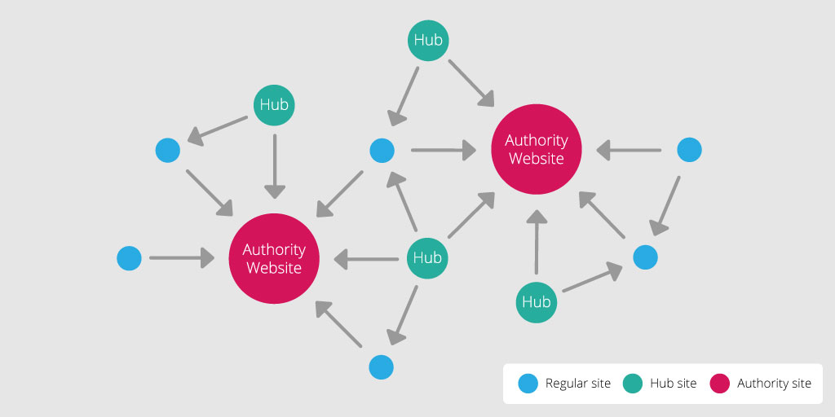
HITS: Capturing Authorities & Hubs (Kleinberg’98)
Intuitions of HITS (Hyperlink Induced Topic Search)
Pages that are widely cited are good authorities
Pages that cite many other pages are good hubs
The key idea of HITS
Good authorities are cited by good hubs
Good hubs point to good authorities
Iterative reinforcement …
AA^{T} is the co-citation matrix and A^{T}A is the bibliographic coupling matrix. Authority centrality is eigenvector centrality for the co-citation network

Slide 26
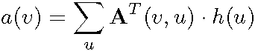
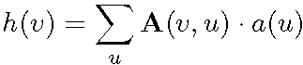
Centrality Measures on the Web (III): HITS (Computing Hub & Authority Scores)
For a specific query, a page of high Pagerank score may not be that relevant
HITS (Hyperlink Induced Topic Search) computes two values for a page
Authority score: analogous to pagerank/prestige scores
Hub score: based on how many “good” pages it points to
How is HITS query-based?
first uses standard search engines to retrieve the set of relevant pages
then expands the set to include any page that point to or is pointed to by) some pages in the set
Any pages originating from the same host are eliminated
HITS is only applied on this expanded query-specific graph G
Computation:
In matrix computation (essentially two eigenvector computation):

Slide 27
Metrics (Measures) in Social Network Analysis (I)
Betweenness: The extent to which a node lies between other nodes in the network. This measure takes into account the connectivity of the node's neighbors, giving a higher value for nodes which bridge clusters. The measure reflects the number of people who a person is connecting indirectly through their direct links
Bridge: An edge is a bridge if deleting it would cause its endpoints to lie in different components of a graph
Centrality: This measure gives a rough indication of the social power of a node based on how well they "connect" the network. "Betweenness", "Closeness", and "Degree" are all measures of centrality
Centralization: The difference between the number of links for each node divided by maximum possible sum of differences. A centralized network will have many of its links dispersed around one or a few nodes, while a decentralized network is one in which there is little variation between the number of links each node possesses
Closeness: The degree an individual is near all other individuals in a network (directly or indirectly). It reflects the ability to access information through the "grapevine" of network members. Thus, closeness is the inverse of the sum of the shortest distances between each individual and every other person in the network

Slide 28
Metrics (Measures) in Social Network Analysis (II)
Clustering coefficient: A measure of the likelihood that two associates of a node are associates themselves. A higher clustering coefficient indicates a greater 'cliquishness'
Cohesion: The degree to which actors are connected directly to each other by cohesive bonds. Groups are identified as ‘cliques’ if every individual is directly tied to every other individual, ‘social circles’ if there is less stringency of direct contact, which is imprecise, or as structurally cohesive blocks if precision is wanted
Degree (or geodesic distance): The count of the number of ties to other actors in the network
(Individual-level) Density: The degree a respondent's ties know one another/ proportion of ties among an individual's nominees. Network or global-level density is the proportion of ties in a network relative to the total number possible (sparse versus dense networks)
Flow betweenness centrality: The degree that a node contributes to sum of maximum flow between all pairs of nodes (not that node)
Eigenvector centrality: A measure of the importance of a node in a network. It assigns relative scores to all nodes in the network based on the principle that connections to nodes having a high score contribute more to the score of the node in question

Slide 29
Metrics (Measures) in Social Network Analysis (III)
Local Bridge: An edge is a local bridge if its endpoints share no common neighbors. Unlike a bridge, a local bridge is contained in a cycle
Path Length: The distances between pairs of nodes in the network. Average path-length is the average of these distances between all pairs of nodes
Prestige: In a directed graph prestige is the term used to describe a node's centrality. "Degree Prestige", "Proximity Prestige", and "Status Prestige" are all measures of Prestige
Radiality Degree: an individual’s network reaches out into the network and provides novel information and influence
Reach: The degree any member of a network can reach other members of the network
Structural cohesion: The minimum number of members who, if removed from a group, would disconnect the group
Structural equivalence: Refers to the extent to which nodes have a common set of linkages to other nodes in the system. The nodes don’t need to have any ties to each other to be structurally equivalent.
Structural hole: Static holes that can be strategically filled by connecting one or more links to link together other points

Slide 30
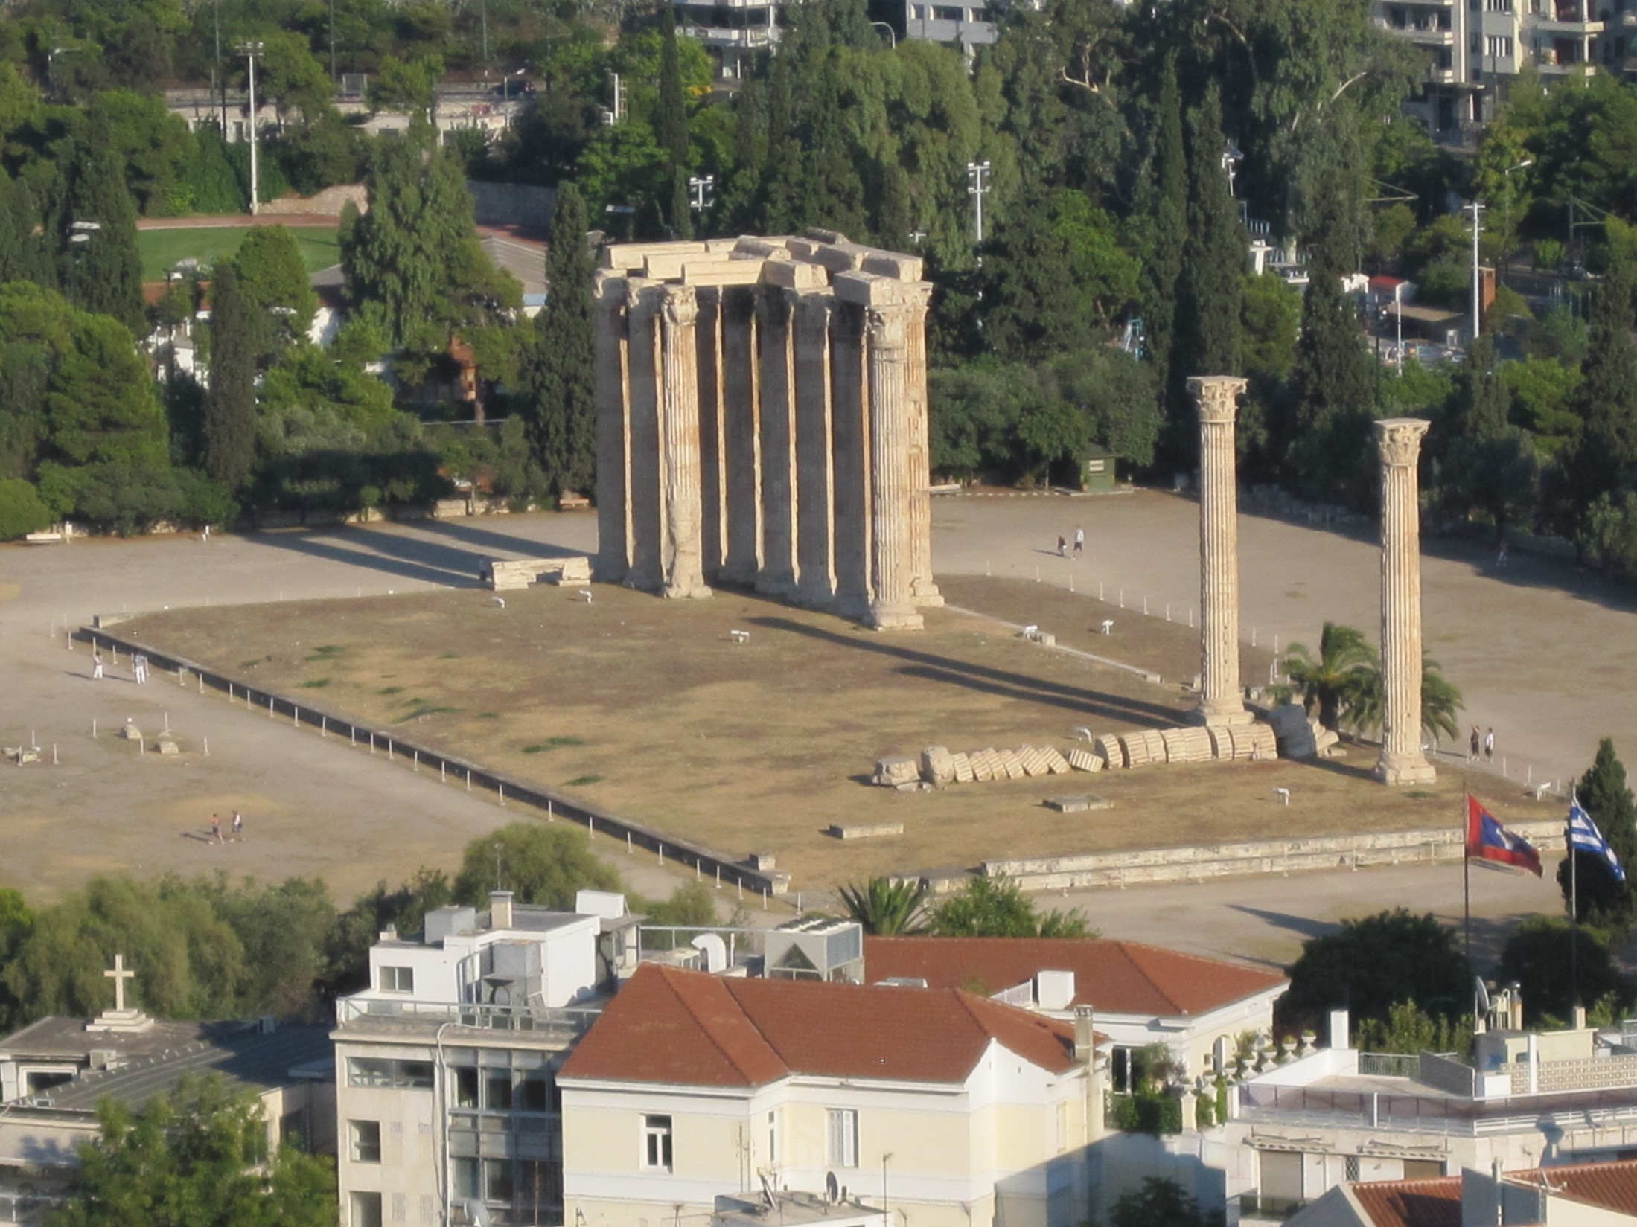

Slide 31
Introduction to Networks
Basic Measures of Networks
Centrality Analysis in Networks
Modeling of Network Formation
Primitives of Social Networks
Summary

Slide 32
Why Network Modeling?
Many real-world networks exhibit certain common characteristics, even though they come from different domains, e.g., communication, social, and biological networks
A typical network has the following common properties:
Few connected components:
often only 1 or a small number, independent of network size
Small diameter:
often a constant independent of network size (like 6)
growing only logarithmically with network size or even shrink?
typically exclude infinite distances
A high degree of clustering:
considerably more so than for a random network
A heavy-tailed degree distribution:
a small but reliable number of high-degree vertices
often of power law form

Slide 33
Probabilistic Models of Networks
All of the network generation models we will study are probabilistic or statistical in nature
They can generate networks of any size
They often have various parameters that can be set:
size of network generated
average degree of a vertex
fraction of long-distance connections
The models generate a distribution over networks
Statements are always statistical in nature:
with high probability, diameter is small
on average, degree distribution has heavy tail
Thus, we’re going to need some basic statistics and probability theory

Slide 34
Some Models of Network Generation
Erdös-Rényi Random graph model:
Gives few components and small diameter
does not give high clustering and heavy-tailed degree distributions
is the mathematically most well-studied and understood model
Watts-Strogatz small world graph model:
gives few components, small diameter and high clustering
does not give heavy-tailed degree distributions
Barabási-Albert Scale-free model:
gives few components, small diameter and heavy-tailed distribution
does not give high clustering
Hierarchical network:
few components, small diameter, high clustering, heavy-tailed
Affiliation network:
models group-actor formation

Slide 35

Erdös-Rényi (ER) Random Graph Model
A random graph is obtained by starting with a set of N vertices and adding edges between them at random
Different random graph models produce different probability distributions on graphs
Most commonly studied is the Erdős–Rényi model, denoted G(N, p), in which every possible edge occurs independently with probability p
G(N, p): a network of N nodes, each node pair is connected with probability of p
Paul Erdős and Alfréd Rényi: "On Random Graphs” (1959)
E. N. Gilbert: “Random Graphs” (1959) (proposed independently)
Usually, N is large and p ~ 1/N
Choices: p = 1/2N, p = 1/N, p = 2/N, p = 10/N, p = log(N)/N, etc.
An alternative model: G(N, L), L: a fixed total # of edges, placed randomly
Pál Erdös (1913-1996)

Slide 36
Degree Distribution of Random Graphs
The degree distribution of a random (small) network follows binomial distribution:
The probability that the remaining links are missing
The probability that k of its links are present
# of ways to select k links from N−1 potential links
Most real network are sparse, i.e., avg degree
The degree density of a large network is well approximated by Poisson distribution
Degree distribution of a network with <k> = 50 and N= 10², 10³, 10⁴.
Top row: 3 random networks generated with p=1/6 and N = 12
Bottom: 3 random networks generated with p=0.03, N = 100
Figures courtesy Barabasi 2016

Slide 37
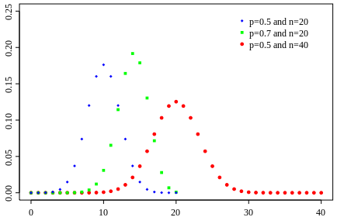
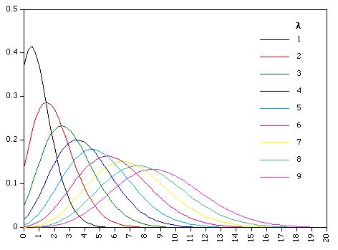
Review: Binomial Distribution vs. Poisson Distribution
The Binomial distribution:
Coin with prob(heads) = p, toss n times, the probability of getting exactly k heads:
For large n and fixed p: approximated well by a normal distribution with µ = np, σ = sqrt(np(1−p))
The Poisson distribution
An event can occur 0, 1, 2, … times in an interval
λ: The average # of events in an interval
We have:
Binomial distribution with large n, p = λ /n (λ fixed)
converges to Poisson distribution with mean λ
Figures courtesy Wikipedia

Slide 38
Real Networks Do Not Fit the Random Network Model
Property of random networks: Comparable degrees
In a large random network the degree of most nodes is in the narrow vicinity of ‹k›
Real networks are not Poisson (Real nets have hubs + wide degree spread)
The Poisson form significantly underestimates the number of high degree nodes
The spread in the degree of real networks is much wider than expected in a random network (if Internet were random, we expect σ = 2.57, but σ_{Internet} = 14.14)
The degree distribution of the (a) Internet, (b) science collaboration network, and (c) protein interaction network
Figures courtesy Barabasi 2016
Figures courtesy Barabasi 2016

Slide 39
The Small World Phenomenon & Erdös Number
Small world phenomenon (Six degrees of separation)
Stanley Milgram’s experiments (1960s)
Microsoft Instant Messaging (IM) experiment: J. Leskovec & E. Horvitz (WWW’08)
240 M active user accounts: Est. avg. distance 6.6 & est. mean median 7
Why small world? Let N: # of nodes, d: distance, <k>: average degree
In today’s tightly connected world:
Erdös number: Distance from him/her to Erdös in the coauthor graph
Paul Erdös (a mathematician who published about 1500 papers)
Similarly, Kevin Bacon number (co-appearance in a movie)
World population
Average connectivity

Slide 40
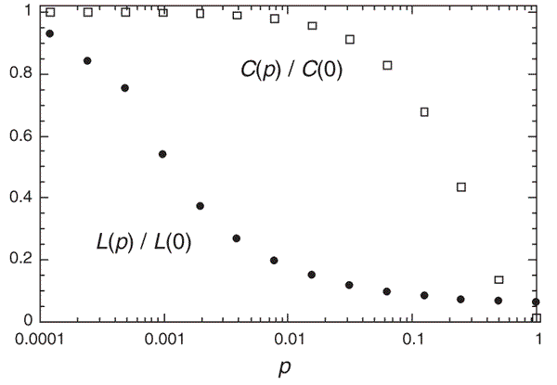
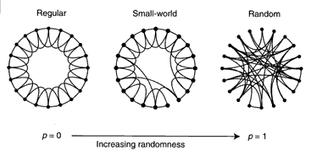
The Watts and Strogatz Model
A random network has low local clustering coefficient:
The Watts and Strogatz Model (aka: small world model)
Interpolates between regular lattice and a random network to generate graphs with
Small-world: short average path lengths
High clustering coefficient:
L_{i}: Expected # of links between the node i’s k_{i} neighbors
Possible # of links between the node i’s k_{i} neighbors
Duncan J. Watts & Steven Strogatz, Nature 1998)
p: the prob. each link is rewired to a randomly chosen node
C(p) : clustering coeff.
L(p) : average path length

Slide 41
Real Networks Are Not Random
The random model does not fit many real networks, e.g., WWW
Mapping WWW into log-log plot: It follows a power-law not Poisson distribution
A scale-free network is a network whose degree distribution follows a power law
Power law vs. Poisson distributions:
For small k, power law is above Poisson: more small-degree nodes
For k in the vicinity of <k>, power law is below Poisson: an excess of nodes with k ≈ <k> in a random network
For large k, power law is above Poisson: prob. of observing hubs is orders of magnitude higher in a scale-free than in a random network
γ_{in}= 2.1
γ_{out} = 2.45
〈k_{in}〉 = 〈k_{out}〉 = 4.60
Degree distribution of WWW vs. that predicted by Poisson (green)
R. Albert, H. Jeong, A-L Barabasi, Nature, 401 130 (1999)

Slide 42
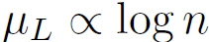
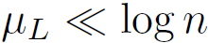
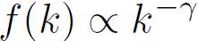
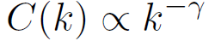
Common Properties of Real Networks
Real network: large, sparse (# of edges |E| = O(n), n: # of nodes)
Small-world property: Avg. path length µ_{L} scales logarithmically with n (# of nodes in the graph):
Ultra-small-world property:
Scale-free property (power law distribution): most nodes have very small degree, but a few hub nodes have high degrees
The probability that a node has degree k:
log-log plot shows a straight line:
Clustering effect:
Two nodes are more likely to be connected if they share a common neighbor
Clustering effect: a high clustering coefficient for graph G
C(k): avg clustering coefficient for nodes with degree k
Power law relationship between C(k) and k:

Slide 43
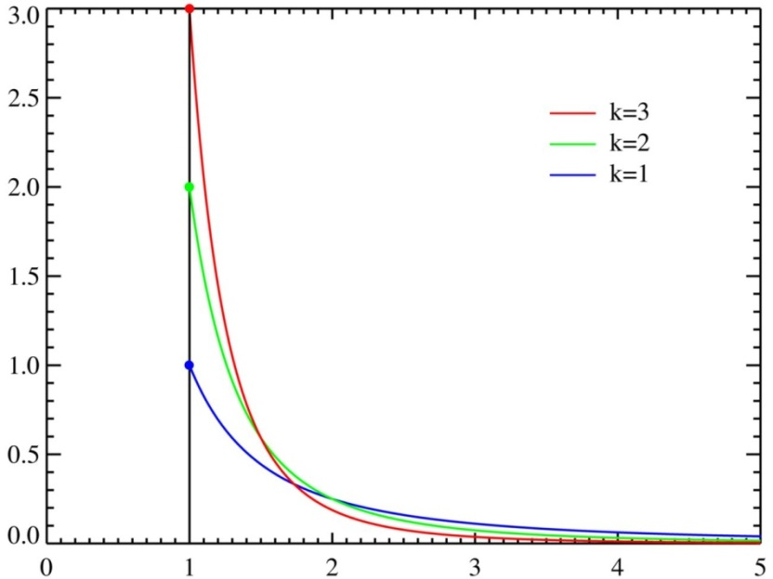
Power Law (or Pareto) Distributions
Pareto distribution (heavy-tailed, or power law):
Pareto(x|k, m) = k m^{k} x^{–(k+1)} I(x ≥ m)
x must be greater than some constant m but not too much greater
Distributions: mode = m
mean = km/(k-1) if k > 1
variance = m²k/((k-1)²(k-2)) if k > 2
For variables assuming integer values > 0, probability of value x ~ 1/x^{α}
This is why it is called power law distribution, also referred to as scale-free
If we plot the distribution on a log-log scale, it forms a straight line
Typically 0 < α < 2; smaller α gives heavier tail
Why long tails or heavy tails? For binomial, normal, and Poisson distributions, the tail probabilities approach 0 exponentially fast
What kind of phenomena does this distribution model?
Word frequency vs their rank (the, of, …); wealth distribution; …

Slide 44
Distinguishing Distributions in Data
All these distributions are idealized models
In practice, we do not see distributions, but data
Typical procedure to distinguish between Poisson, power law, …
Might restrict our attention to a range of values of interest
Get count of observed data in equal-sized bins: look at counts on a log-log plot
Power law: log(P(X = x)) = log(1/x^{α}) = – α log(x)
linear, slope –α
Normal: log(P(X = x)) = log(α exp(–x²/b)) = log(α) – x²/b
non-linear, concave near mean
Poisson: log(P(X = x)) = log(exp(–λ) λ^{x}/x!)
also non-linear

Slide 45
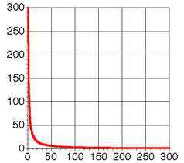
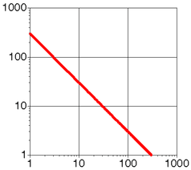
Zipf’s Law and Zipf Distribution
A Zipf distribution with 300 data points
Pareto distribution vs. Zipf’s Law
Pareto distributions are continuous probability distributions
Zipf's law: a discrete counterpart of the Pareto distribution
Zipf's law example:
Given some corpus of natural language utterances, the frequency of any word is inversely proportional to its rank in the frequency table
The most frequent word will occur approximately twice as often as the second most frequent word, which occurs twice as often as the fourth most frequent word, etc.
Example: rank events by their frequency of occurrences. The resulting distribution often is a power law!
Other examples: North America city sizes, personal income, file sizes, genus sizes (number of species)
Linear scales on both axes
Log scales on both axes

Slide 46
Discovered by Examining the Real World…
Watts examines three real networks as case studies:
the Kevin Bacon graph
the Western states power grid
the C. elegans nervous system
For each of these networks, he:
computes its size, diameter, and clustering coefficient
compares diameter and clustering to best Erdos-Renyi approx.
shows that the best α-model approximation is better
important to be “fair” to each model by finding best fit
Overall,
if we care only about diameter and clustering, α is better than p

Slide 47
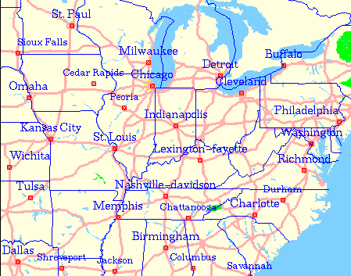
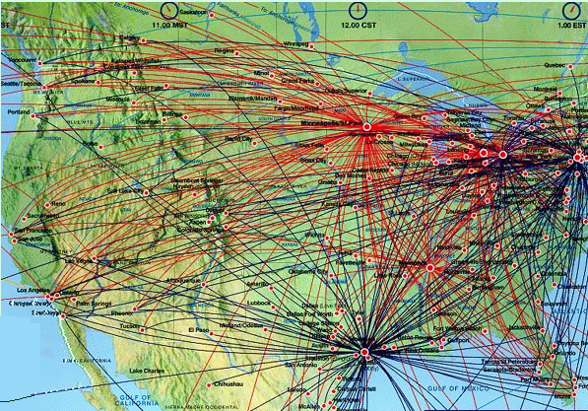
Not All the Networks Are Scale-Free
Poisson distribution
Power-law distribution
Highway Network
Scale-free Network

Slide 48
Barabási-Albert Model: Preferential Attachment
Major limitation of the Watts-Strogatz model
It produces graphs that are homogeneous in degree
Real networks are often inhomogeneous in degree, having hubs and a scale-free degree distribution (scale-free networks)
Scale-free networks are better described by the preferential attachment family of models, e.g., the Barabási–Albert (BA) model
“rich-get-richer”: New edges are more likely to link to nodes with higher degrees
Preferential attachment: The probability of connecting to a node is proportional to the current degree of that node
This leads to the proposal of a new model: scale-free network, a network whose degree distribution follows a power law, at least asymptotically

Slide 49
Scale-Free Networks: Major Ideas
The number of nodes (N) is not fixed
Networks continuously expand by additional new nodes
WWW: addition of new nodes
Citation: publication of new papers
The attachment is not uniform
A node is linked with higher probability to a node that already has a large number of links
WWW: new documents link to well known sites (CNN, Yahoo, Google)
Citation: Well cited papers are more likely to be cited again

Slide 50
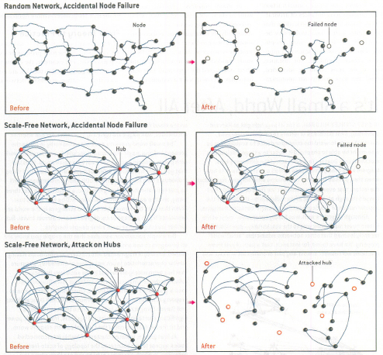
Robustness of Random vs. Scale-Free Networks
The accidental failure of a number of nodes in a random network can fracture the system into non-communicating islands
Scale-free networks are more robust in the face of such failures
Scale-free networks are highly vulnerable to a coordinated attack against their hubs

Slide 51
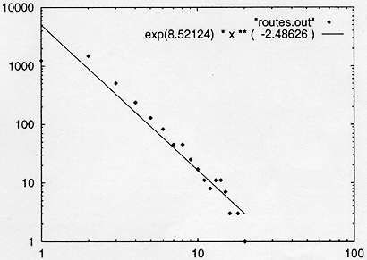
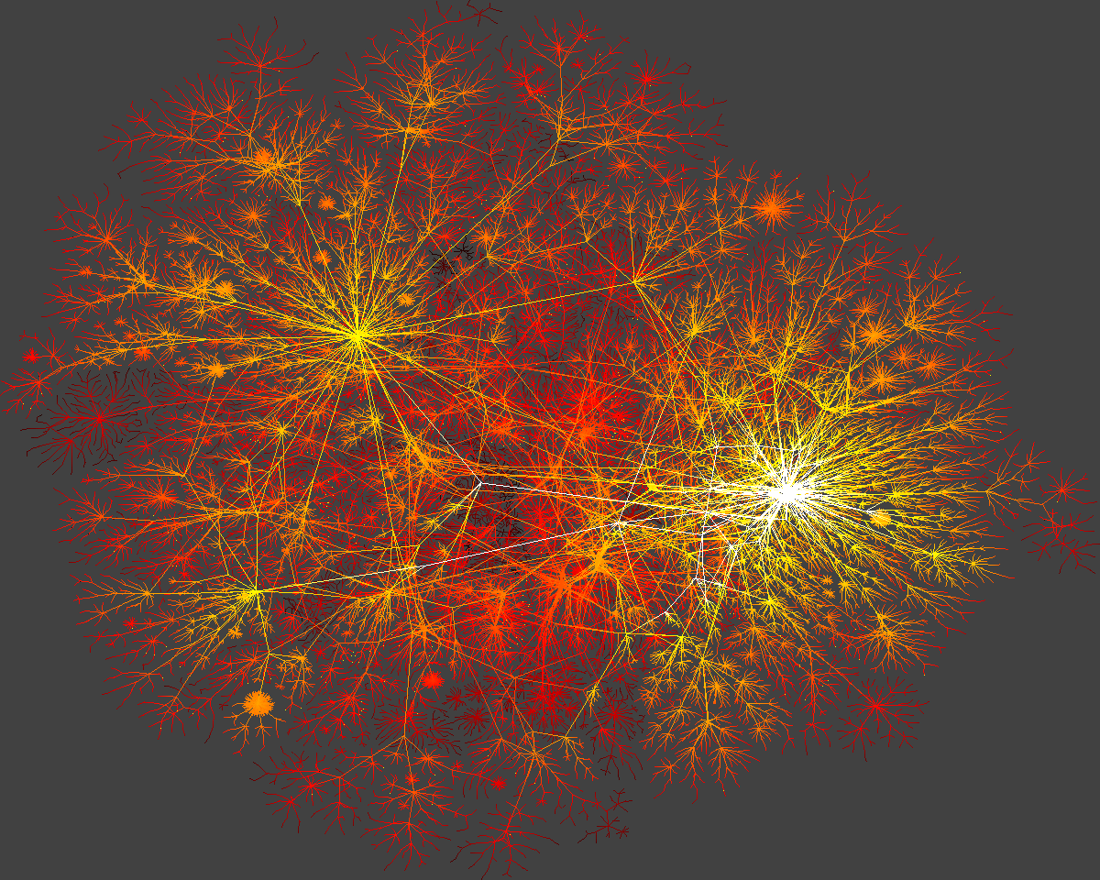
Real World Case 1: Internet Backbone
Nodes: computers, routers Links: physical lines
Internet-Map
(Faloutsos, Faloutsos and Faloutsos, 1999)

Slide 52


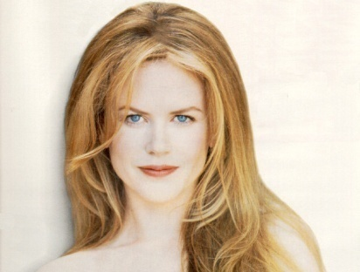
Real World Case: Actor Connectivity
Days of Thunder (1990) Far and Away (1992) Eyes Wide Shut (1999)
Nodes: actors Links: cast jointly
N = 212,250 actors ⟨k⟩ = 28.78
P(k) ~k^{-γ}
γ=2.3

Slide 53
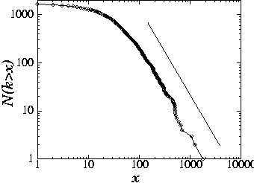
Real World Case: Science Citation Index
25
Nodes: papers Links: citations
Witten-Sander
PRL 1981
1736 PRL papers (1988)
2212
P(k) ~k^{-γ}
(γ = 3)
(S. Redner, 1998)

Slide 54
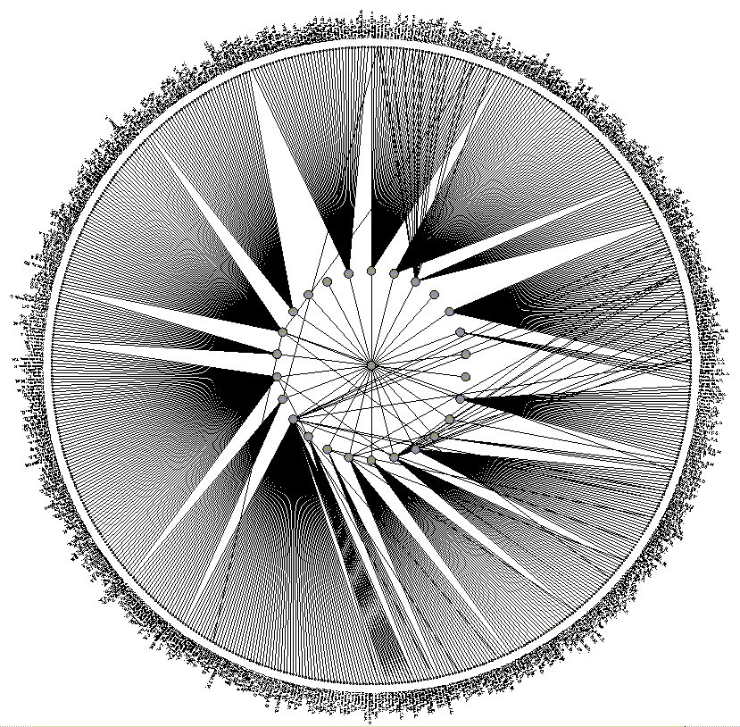
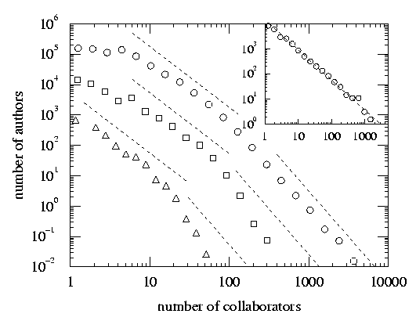
Real World Case: Science Co-authorship
Nodes: scientist (authors) Links: write paper together
(Newman, 2000, H. Jeong et al 2001)

Slide 55
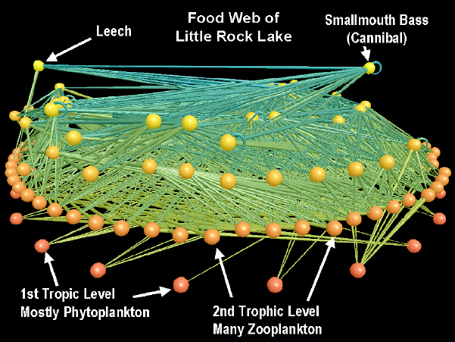
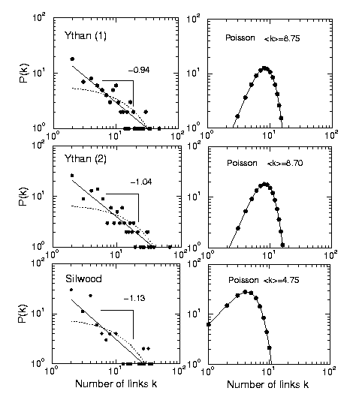
Real World Case: Food Web
Nodes: trophic species Links: trophic interactions
R. Sole (cond-mat/0011195)
R.J. Williams, N.D. Martinez Nature (2000)

Slide 56
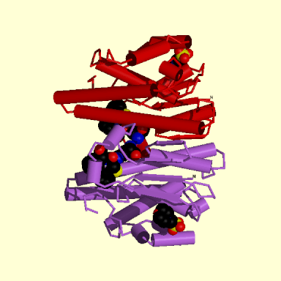








Real World Case: Biology Map
GENOME
protein-gene interactions
PROTEOME
protein-protein interactions
METABOLISM
Bio-chemical reactions
Citrate Cycle

Slide 57


Biological Pathways and Complex Biological Networks

Slide 58


Protein Interaction Map: Yeast Protein Network
Nodes: proteins
Links: physical interactions (binding)
P. Uetz, et al., Nature 403, 623-7 (2000)

Slide 59
Patterns in Static vs. Dynamic Networks
Static graphs
Skewed/power-law degree distribution
Power-law eigenvalue distribution
Small diameter
Triangle power law
Triangle-degree power law
Dynamic graphs
Shrinking diameter
Densification power law
Jelling point
Oscillating size of NLCC (non-largest connected components)
Principal eigenvalue over time
Based on D. Chakrabarti and C. Faloutsos, Graph Mining: Laws, Tools, and Case Studies, Morgan & Claypool, 2012

Slide 60
Patterns in Weighted Networks
Weighted Static Graphs
Superlinear weight-degree relationship (’snapshot power law’)
Weighted Dynamic Graphs
WPL –Weight Power Law. Super-linear relationships, over time between total graph weight W(t), total edge count E(t) etc.
WLPL – principal eigenvalue of weighted graph follows a power law over time, with respect to edge count
Based on D. Chakrabarti and C. Faloutsos, Graph Mining: Laws, Tools, and Case Studies, Morgan & Claypool, 2012

Slide 61
Modeling Network Evolution
Densification power law
The # of edges grows super-linearly (i.e., more than linearly) to # of nodes, following a power law, with a positive densification exponent
Shrinking diameter: The diameter of the graph shrinks as a graph grows over time
The Forest-Fire model: A preferential-attachment model that matches the densification power law and the shrinking diameter patterns of graph evolution
The graph grows one node at a time. The new node v adds links to the existing node according to a “forest fire” process
Pick an ambassador node w uniformly at random and the links to w
Select some of ambassador’s edges, and follow these edges and repeat
Similar to capture a “forest fire” at w and spread to other nodes
where β = 1.03~1.07 in many real graphs
J. Leskovec, J. Kleinberg, and C. Faloutsos. “Graphs over time: Densification laws, shrinking diameters and possible explanations. KDD’05

Slide 62


Slide 63
Introduction to Networks
Basic Measures of Networks
Centrality Analysis in Networks
Modeling of Network Formation
Primitives of Social Networks
Summary

Slide 64
Social Networks
Social network: A social structure made of nodes (individuals or organizations) that are related to each other by various interdependencies like friendship, kinship, like, ...
Graphical representation
Nodes = members
Edges = relationships
Examples of typical social networks on the Web
Social bookmarking (Del.icio.us)
Friendship networks (Facebook, Myspace, LinkedIn)
Blogosphere
Media Sharing (Flickr, Youtube)
Folksonomies

Slide 65
Web 2.0 Examples
Blogs
Blogspot
Wordpress
Wikis
Wikipedia
Social Networking Sites
Facebook
Orkut
Digital media sharing websites
Youtube
Flickr
Social Tagging
Del.icio.us
Others
Twitter
Yelp

Slide 66
Adapted from H. Liu & N. Agarwal, KDD’08 tutorial

Slide 67

Society: Social Networks
Nodes: individuals
Links: social relationship (family/work/friendship/etc.)
S. Milgram (1967)
Six Degrees of Separation
John Guare
Social networks: Many individuals with diverse social interactions between them

Slide 68

Communication Networks
The Earth is developing an electronic nervous system, a network with diverse nodes and links are
- Computers
- Routers
- Satellites
- Phone lines
- TV cables
- EM waves
Communication networks: Many non-identical components with diverse connections between them

Slide 69

Biological Networks
Complex systems
Made of many non-identical elements connected by diverse interactions
NETWORK

Slide 70
“Natural” Networks and Universality
Consider many kinds of networks: social, technological, business, economic, content,…
These networks tend to share certain informal properties:
large scale; continual growth
distributed, organic growth: vertices “decide” who to link to
interaction restricted to links
mixture of local and long-distance connections
abstract notions of distance: geographical, content, social,…
Social network theory and link analysis
Do natural networks share more quantitative universals?
What would these “universals” be?
How can we make them precise and measure them?
How can we explain their universality?

Slide 71
Introduction to Networks
Basic Measures of Networks
Centrality Analysis in Networks
Modeling of Network Formation
Primitives of Social Networks
Summary

Slide 72
Some Typical Network Data Sets
Collaboration graphs
Co-authorships among authors
co-appearance in movies by actors/actresses
Who-Talks-to-Whom graphs
Microsoft IM (Instant-Messaging)-graphs
Information Linkage graphs
Web, citation graphs
Technological graphs
Interconnections among computers
Physical, economic networks
Networks in the Natural World
Food Web: who eats whom
Neural connections within an organism’s brain
Cells metabolism

Slide 73
Summary
Primitives for networks
Measure and metrics of networks
Degree, eigenvalue, Katz, PageRank, HITS
Models of network formation
Erdös-Rényi, Watts and Strogatz, scale-free
Social networks

Slide 74
References: Introduction to Networks
S. Brin and L. Page, The anatomy of a large scale hypertextual Web search engine. WWW7.
S. Chakrabarti, B. Dom, D. Gibson, J. Kleinberg, S.R. Kumar, P. Raghavan, S. Rajagopalan, and A. Tomkins, Mining the link structure of the World Wide Web. IEEE Computer’99
D. Cai, X. He, J. Wen, and W. Ma, Block-level Link Analysis. SIGIR'2004
P. Domingos, Mining Social Networks for Viral Marketing. IEEE Intelligent Systems, 20(1), 80-82, 2005
D. Easley and J. Kleinberg, Networks, Crowds, and Markets: Reasoning About a Highly Connected World, Cambridge Univ. Press, 2010
L. Getoor: Lecture notes from Lise Getoor’s website: www.cs.umd.edu/~getoor/
D. Kempe, J. Kleinberg, and E. Tardos, Maximizing the Spread of Influence through a Social Network. KDD’03
J. M. Kleinberg, Authoritative Sources in a Hyperlinked Environment, J. ACM, 1999
D. Liben-Nowell and J. Kleinberg. The Link Prediction Problem for Social Networks. CIKM’03
M. Newman, Networks: An Introduction, Oxford Univ. Press, 2010
D. Chakrabarti and C. Faloutsos, Graph Mining: Laws, Tools, and Case Studies, Morgan & Claypool, 2012

Slide 75


Slide 76
Probability and Random Variables (A Brief Review)
A random variable X is simply a variable that probabilistically assumes values in some set
set of possible values sometimes called the sample space S of X
Sample space may be small and simple or large and complex
S = {Heads, Tails}, X is outcome of a coin flip
S = {0,1,…,U.S. population size}, X is number voting democratic
S = all networks of size N, X is generated by preferential attachment
Behavior of X determined by its distribution (or density)
For each value x in S, specify p(X = x): these probabilities sum to exactly 1 (mutually exclusive outcomes)
complex sample spaces (such as large networks):
distribution often defined implicitly by simpler components
might specify the probability that each edge appears independently
this induces a probability distribution over networks
may be difficult to compute induced distribution

Slide 77
Independence, Expectation & Variance
Independence:
let X and Y be random variables.
unconditional independence: for any x & y, p(X = x, Y = y) = p(X=x)×p(Y=y)
intuition: value of X does not influence value of Y, vice-versa
conditional independence: p(X, Y |Z) = p(X|Z) p(Y|Z)
Expected (mean) value of X: µ
only makes sense for numeric random variables
“average” value of X according to its distribution
formally, E[X] = ∑_{x ε X} x p(x), i.e., sum over all x in X
always true: E[X + Y] = E[X] + E[Y]
true only for independent random variables: E[XY] = E[X]E[Y]
Variance of X:
Var[X] = E[(X – µ)²]; often denoted by σ²
standard deviation σ = sqrt(Var[X])
Union bound:
for any X, Y, p(X=x, Y=y) ≤ p(X=x) + p(Y=y)

Slide 78
Convergence to Expectations
Let X₁, X₂,…, X_{n} be:
independent random variables
with the same distribution p(X=x)
expectation µ = E[X] and variance σ²
independent and identically distributed (i.i.d.)
essentially n repeated “trials” of the same experiment
natural to examine random variable Z = (1/n) ∑_{i=1:n} X_{i}
example: number of heads in a sequence of coin flips
example: degree of a vertex in the random graph model
E[Z] = E[X]; what can we say about the distribution of Z?
Central Limit Theorem:
as n becomes large, Z becomes normally distributed
with expectation µ and variance σ²/n

Slide 79


The Gaussia (Normal) Distribution
The normal or Gaussian density applies to continuous, real-valued random variables
characterized by mean µ and std. deviation σ
Density at x is defined as (1/(σ sqrt(2π))) exp(-(x-µ)²/2σ²)
Special case µ = 0, σ = 1: α exp(-x²/β) for some constants α, β > 0
peaks at x = µ, then dies off exponentially rapidly
The classic “bell-shaped curve”, e.g., exam scores, human body temperature
Remarks:
can control mean and standard deviation independently
can make as “broad” as we like, but always have finite variance

Slide 80
Small Worlds and Occam’s Razor
For small α, should generate large clustering coefficients
we “programmed” the model to do so
Watts claims that proving precise statements is hard…
But we do not want a new model for every little property
Erdos-Renyi → small diameter
α-model → high clustering coefficient
In the interests of Occam’s Razor, we would like to find
a single, simple model of network generation…
… that simultaneously captures many properties
Watt’s small world: small diameter and high clustering

